Slide 1
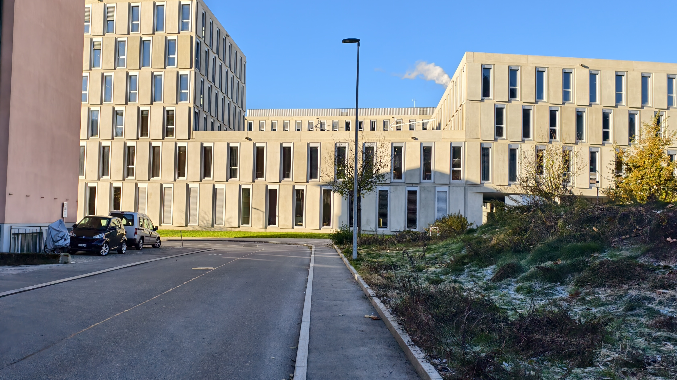
Computer vision and deep learning project
Tommaso Sommaruga
Miro Rava

Slide 2
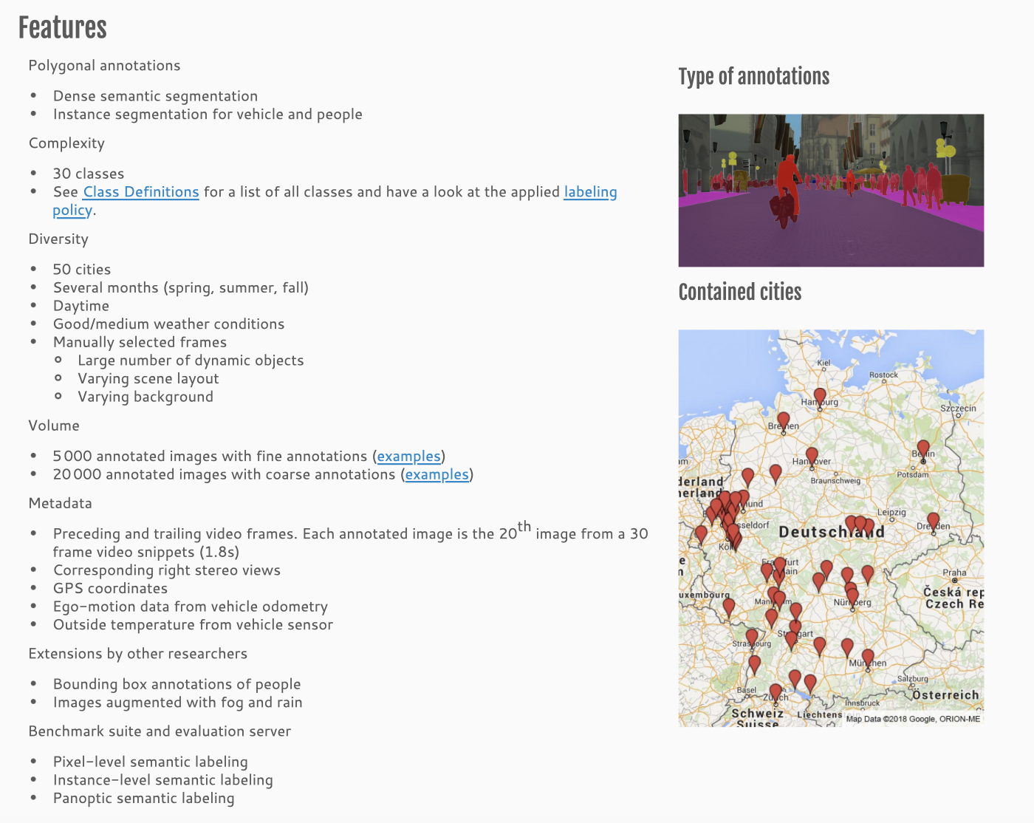
Overview
https://www.cityscapes-dataset.com/dataset-overview/

Slide 3


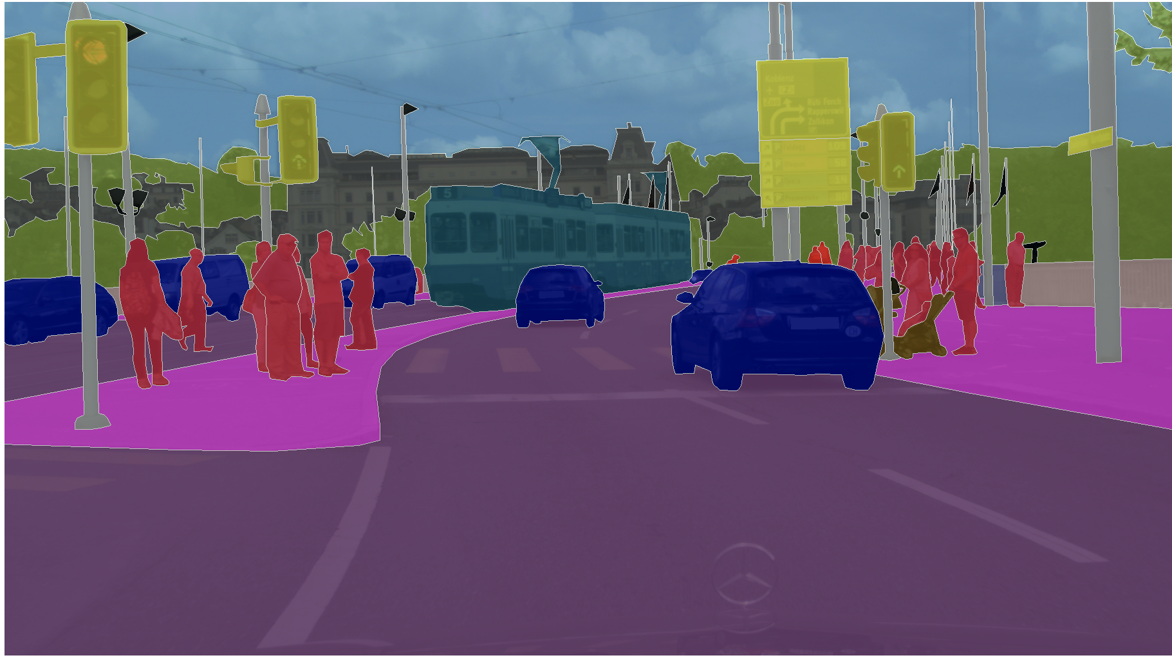

Slide 4
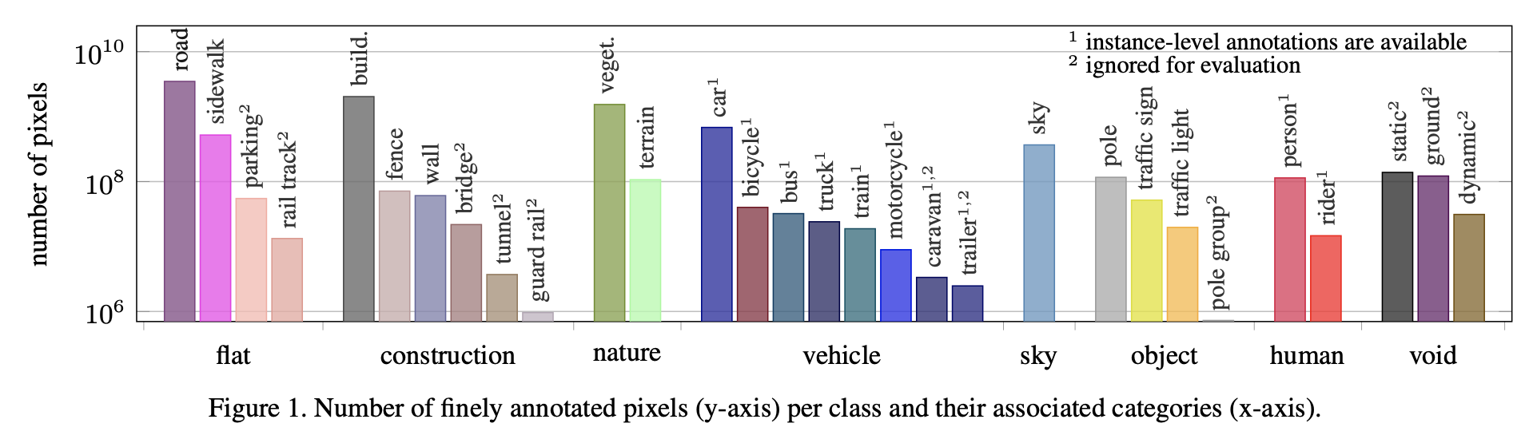
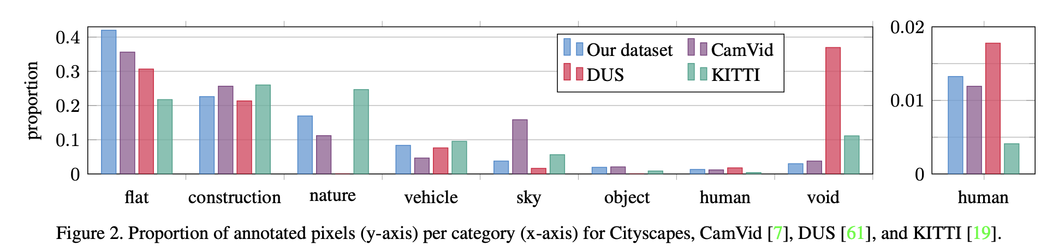
Proportion of objects and pixels

Slide 5
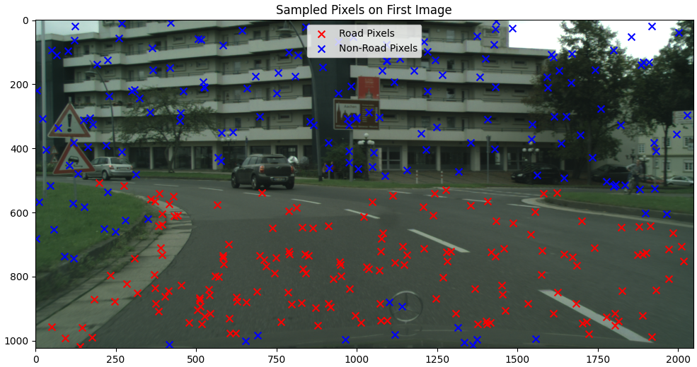
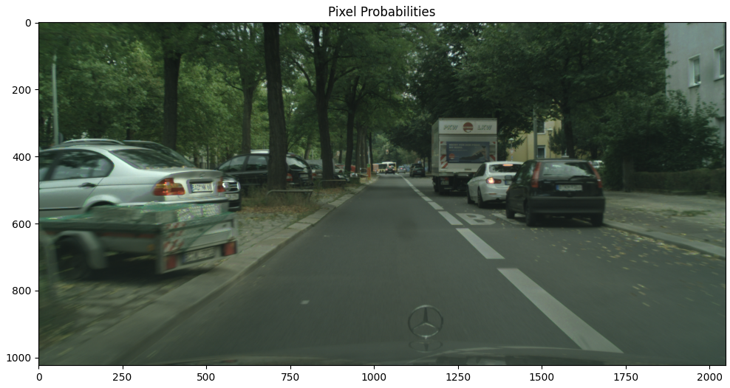
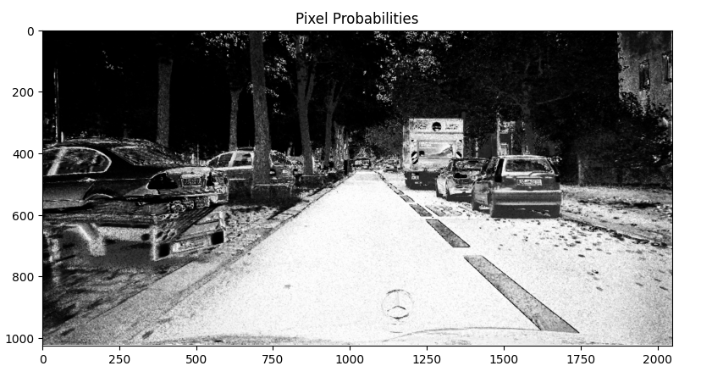
Single Pixel Classifier
Sampling Method
Original Image
Model Result

Slide 6
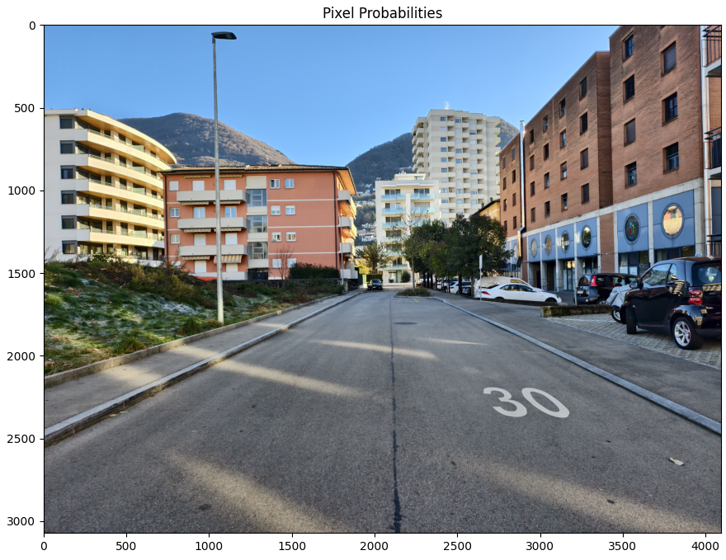
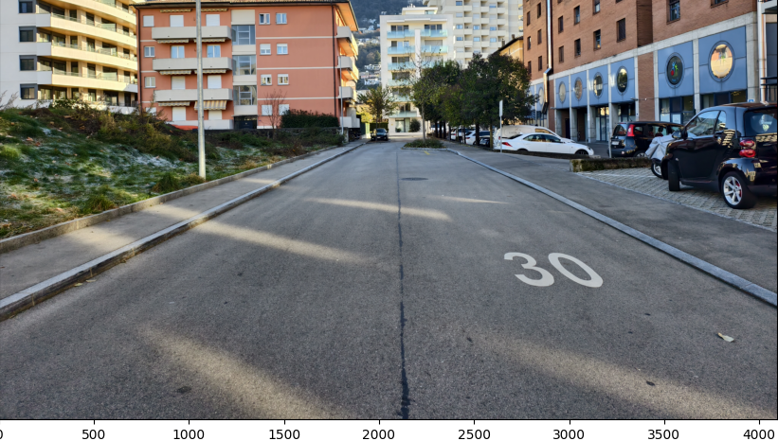
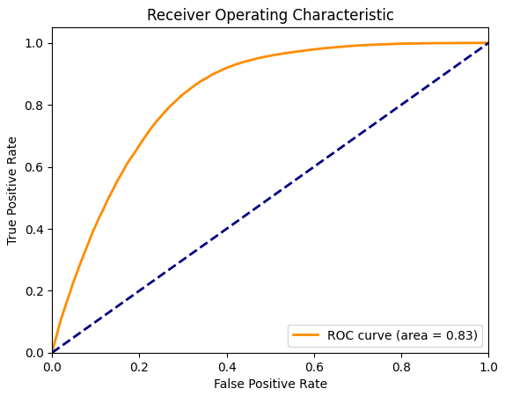
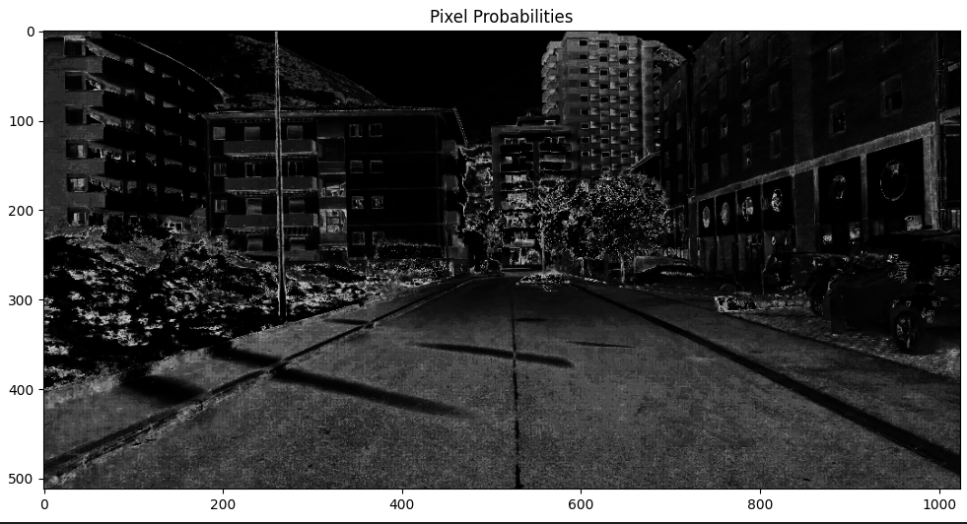
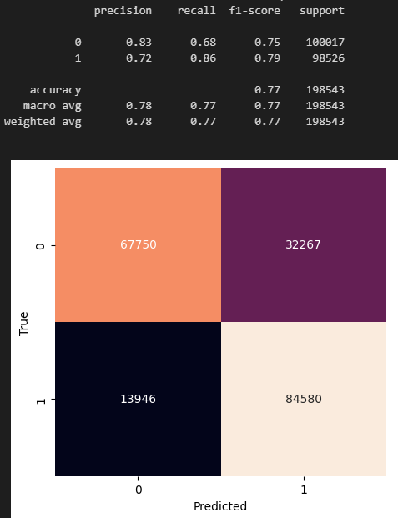
Single Pixel Classifier
Original Image
ROC Curve
Result Image

Slide 7
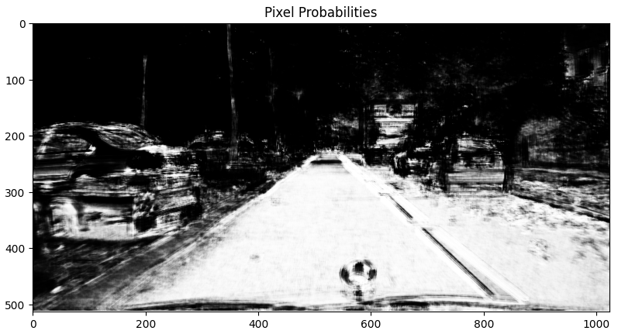
PATCH Classifier
Sampling Method
Original Image
Model Result

Slide 8
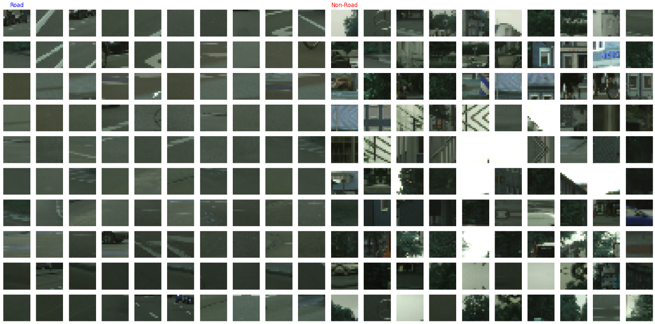
PATCH Classifier
Road Patches
Non Road Patches

Slide 9
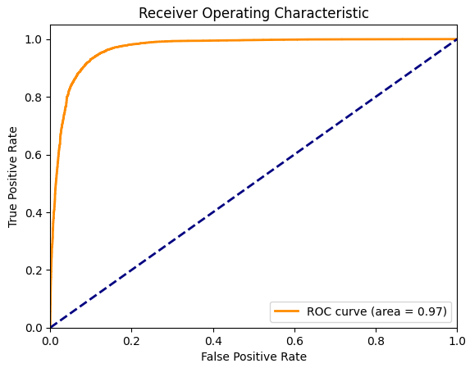
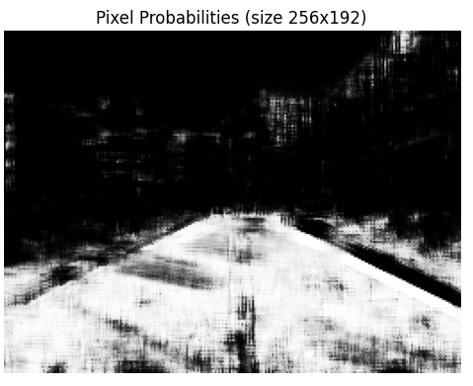
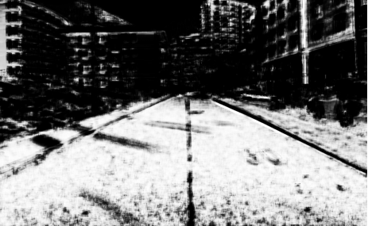
Original Image
PATCH Classifier
ROC Curve
Result Image

Slide 10
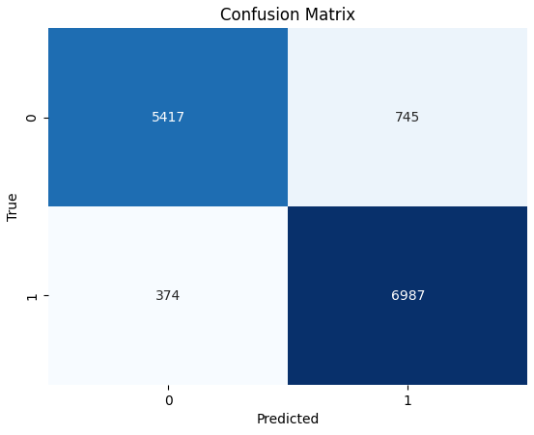
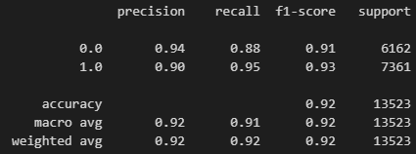
PATCH Classifier
Evaluation Metrics

Slide 11
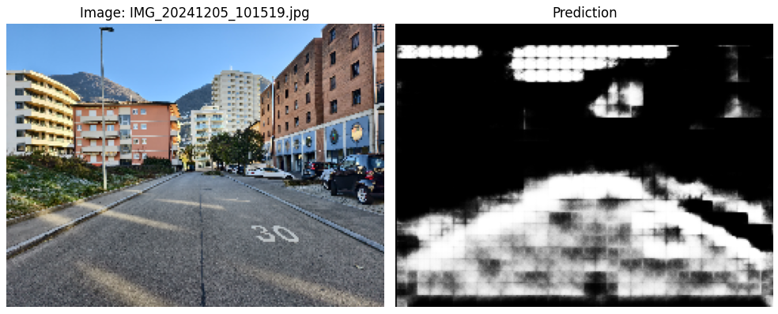
FCNN Classifier

Slide 12
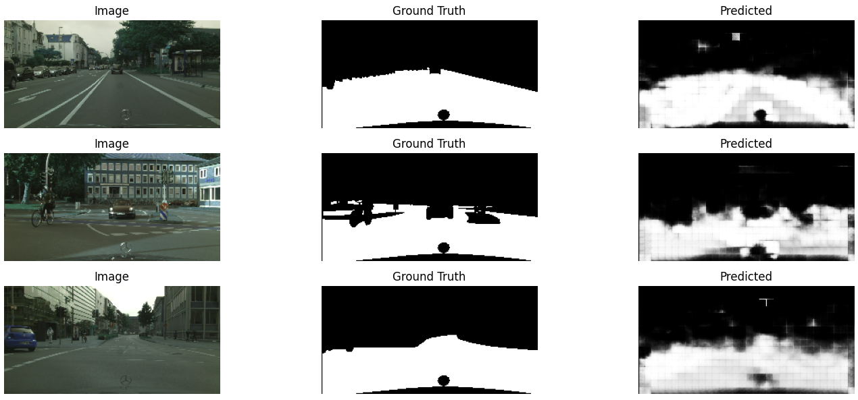
FCNN Classifier

Slide 13
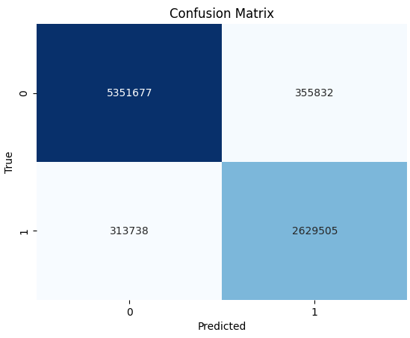
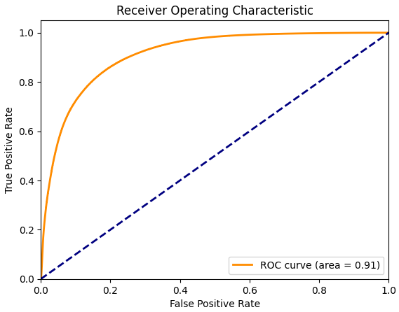
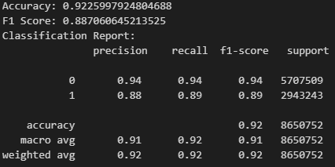
FCNN Classifier
ROC Curve

Slide 14
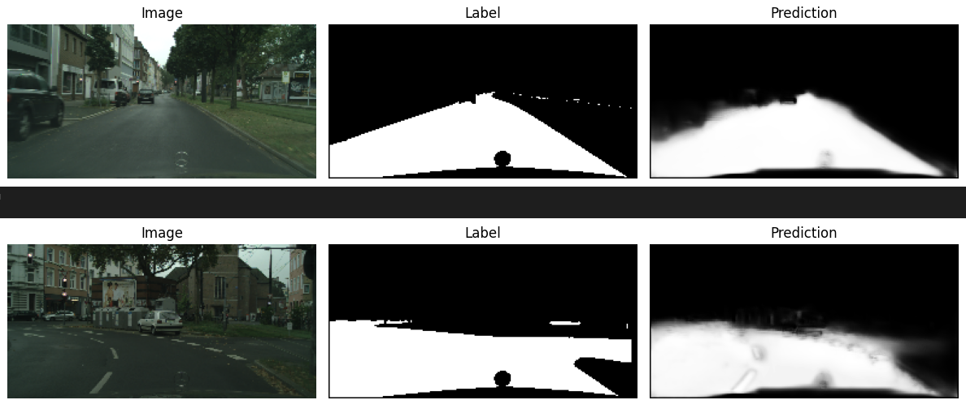
U-NET Classifier
Original Segmentation
Predicted Segmentation
Original Image

Slide 15
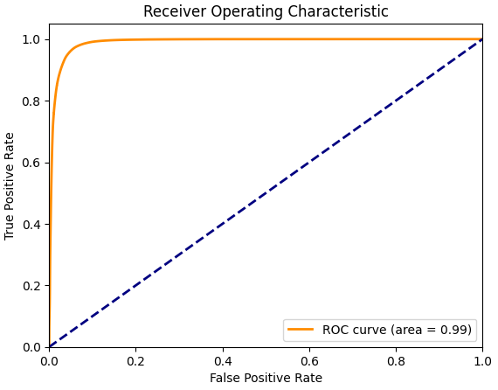
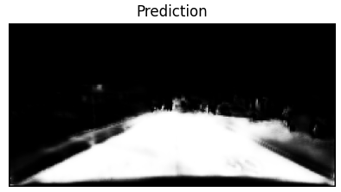
Original Image
U-NET Classifier
ROC Curve
Result Image

Slide 16
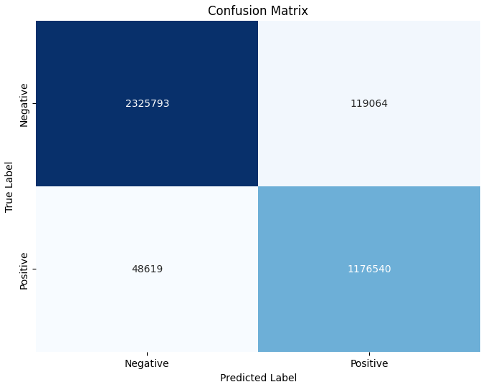
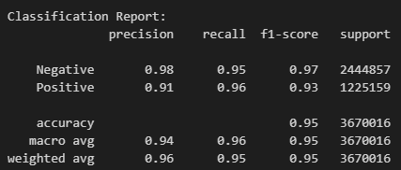
U-NET Classifier
Evaluation Metrics

Slide 17
Comparison of the models
Evaluation Metrics
Pixel
Patch
FCNN
U-NET

Slide 18
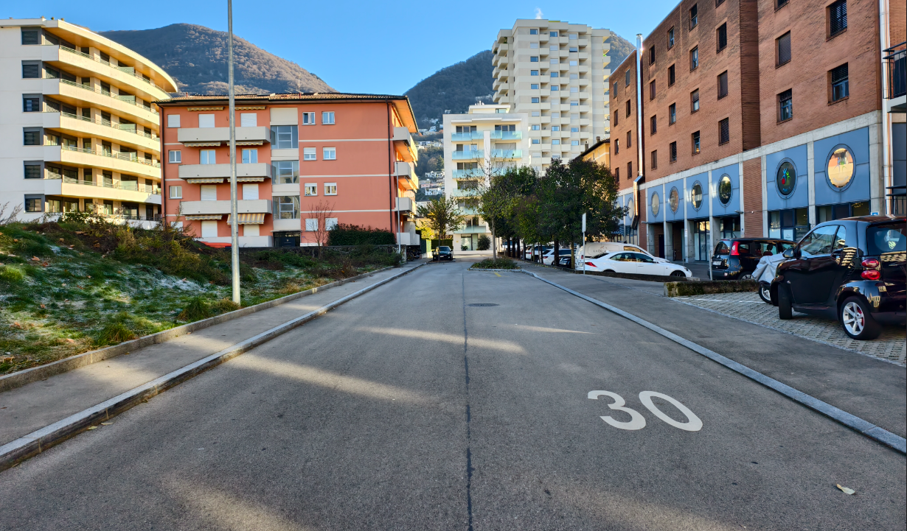
Comparison of the models
Original Image

Slide 19
Comparison of the models
Visual Comparison
Pixel
Patch
FCNN
U-NET

Slide 20
Comparison of the models
Real Time Video feed
TOO LARGE TO UPLOAD TO GITHUB

Slide 21
Q&A
Thank You!

